Slide 1




Seismo-acoustic analysis of Mw 4.2
mining induced earthquake nearby Kiruna, Sweden
Dr. Antoine L. Turquet
Norwegian Seismic Array (NORSAR), Kjeller, Norway
antoine@norsar.no
Poster No. P2.3-149
Vienna Institute for CTBT Science and Technology

Slide 2
Seismo-acoustic analysis of Mw 4.2
mining induced earthquake nearby Kiruna, Sweden
Dr Antoine L. Turquet, Researcher, Norwegian Seismic Array (NORSAR), Kjeller, Norway
P2.3-149
A shallow mine-quake of mb 4.9 occurred in Kiruna, Sweden on 18/04/2020 - 1:11:56 UTC
The mine was immediately evacuated due to aftershock risk.
Preliminary results show that infrasound recorded up to ~300 km from a shallow moderate-magnitude earthquake can provide ground shaking information as well as local amplification caused by topographic and geological features.
ABSTRACT
Infrasound phases were detected at several stations, but in this talk we are focusing on KIR, IS37NO and ARCI arrays.

Slide 3
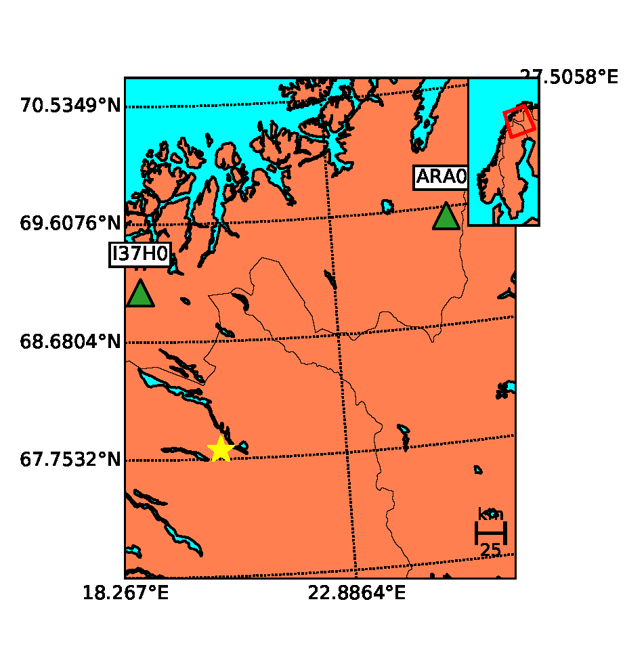
Seismo-acoustic analysis of Mw 4.2
mining induced earthquake nearby Kiruna, Sweden
Dr Antoine L. Turquet, Researcher, Norwegian Seismic Array (NORSAR), Kjeller, Norway
P2.3-149
A shallow (d= 1km) mine-quake of mb 4.9 occurred in Kiruna, Sweden on 18/04/2020 1:11:56
Focal mechanism derived from regional seismic data shows that the signature is different than a conventional mine collapse. The first analyses indicate there might be multiple quasi-simultaneous events.
INTRODUCTION

Slide 4
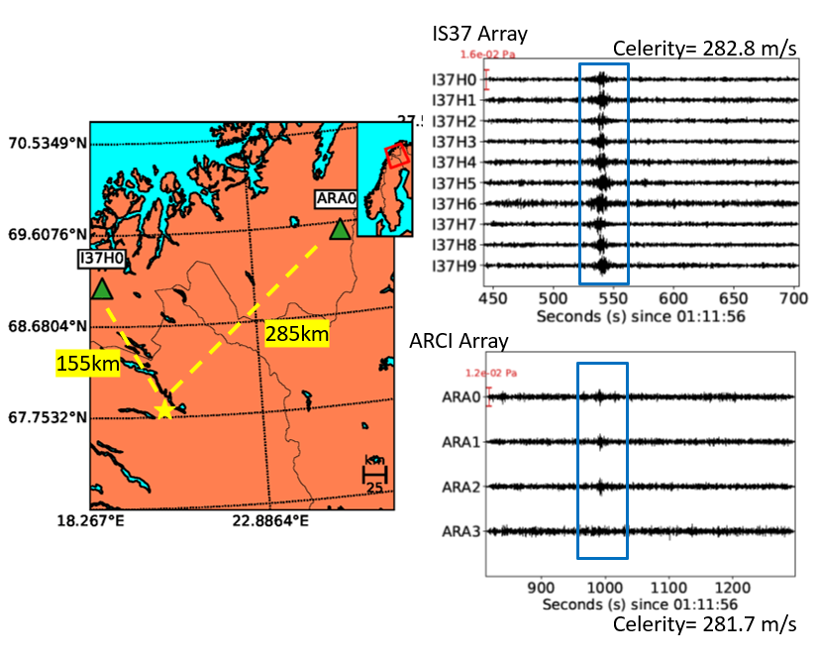
Seismo-acoustic analysis of Mw 4.2
mining induced earthquake nearby Kiruna, Sweden
Dr Antoine L. Turquet, Researcher, Norwegian Seismic Array (NORSAR), Kjeller, Norway
P2.3-149
We are conducting array processing in KIR (near-field) and IS37 and ARCI (far-field).
This preliminary work contains:
f-k analysis
PMCC analysis
Ray tracing
Full-waveform simulations
METHODS

Slide 5
Seismo-acoustic analysis of Mw 4.2
mining induced earthquake nearby Kiruna, Sweden
Dr Antoine L. Turquet, Researcher, Norwegian Seismic Array (NORSAR), Kjeller, Norway
P2.3-149
Far-field
Infrasound signals (1 – 5Hz) show clear stratospheric arrivals at IS37 and ARCI
Signals have similar celerities in both arrivals.
Signals peak around 1-2Hz
Larger distances, atmospheric conditions and wind noise filtering on stations play role on SNR
RESULTS

Slide 6
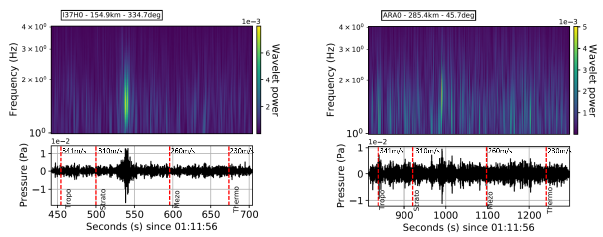
Seismo-acoustic analysis of Mw 4.2
mining induced earthquake nearby Kiruna, Sweden
Dr Antoine L. Turquet, Researcher, Norwegian Seismic Array (NORSAR), Kjeller, Norway
P2.3-149
Far-field
IS37NO
ARCI
Here we analyse further the far-field signals. In the spectrogram we see that the dominant frequency is located between 1-2 Hz. The signal in ARCI is weak and very noisy but still visible.
RESULTS
Arrivals are matching with the theroretical stratospheric arrival values given in (Le Pichon, 2010)
Le Pichon, A., Blanc, E., & Hauchecorne, A. (Eds.). (2010). Infrasound monitoring for atmospheric studies. Springer

Slide 7
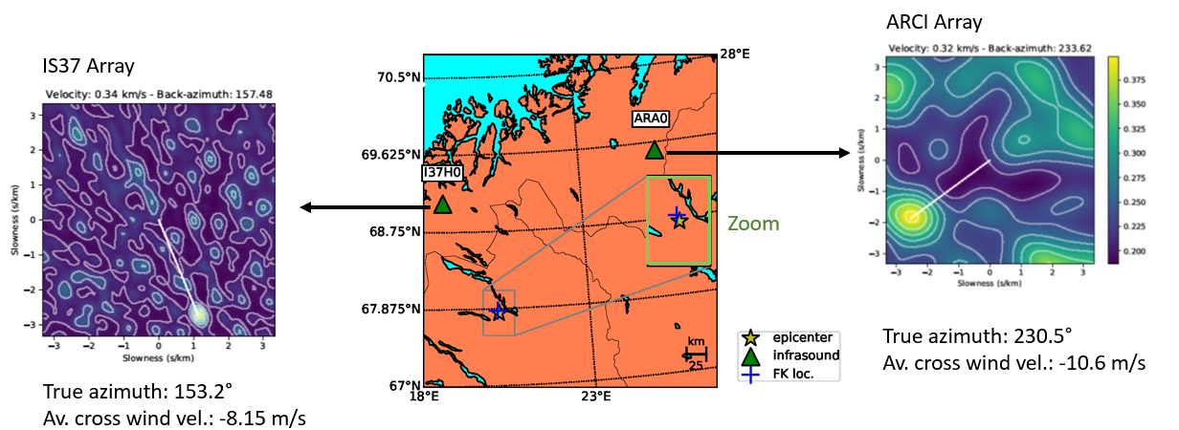
Seismo-acoustic analysis of Mw 4.2
mining induced earthquake nearby Kiruna, Sweden
Dr Antoine L. Turquet, Researcher, Norwegian Seismic Array (NORSAR), Kjeller, Norway
P2.3-149
Far-field
RESULTS
Infrasound back-azimuth at IS37 and ARCI arrays indicate a location <1km from Kiruna mine pit

Slide 8
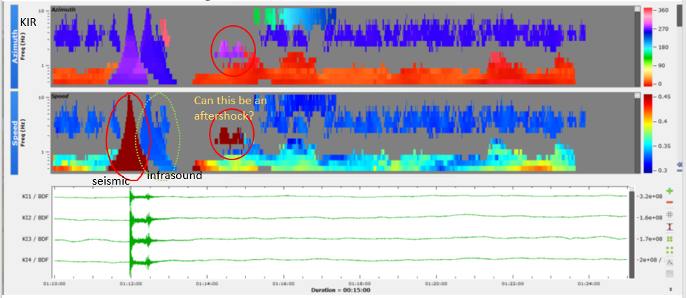
Seismo-acoustic analysis of Mw 4.2
mining induced earthquake nearby Kiruna, Sweden
Dr Antoine L. Turquet, Researcher, Norwegian Seismic Array (NORSAR), Kjeller, Norway
P2.3-149
Near-field
Station KIR located a few kilometers away from the mine. PMCC gives velocity, and azimuth variations by decomposing into wavelets along the duration of the signal.
Also we can generate families of wave packages having similar characteristics.
RESULTS
Here, we can identify both the seismic and infrasonic components and investigate further.
For example: Is this patch belong to an aftershock? We will collaborate with the mining company to find an explanation.

Slide 9
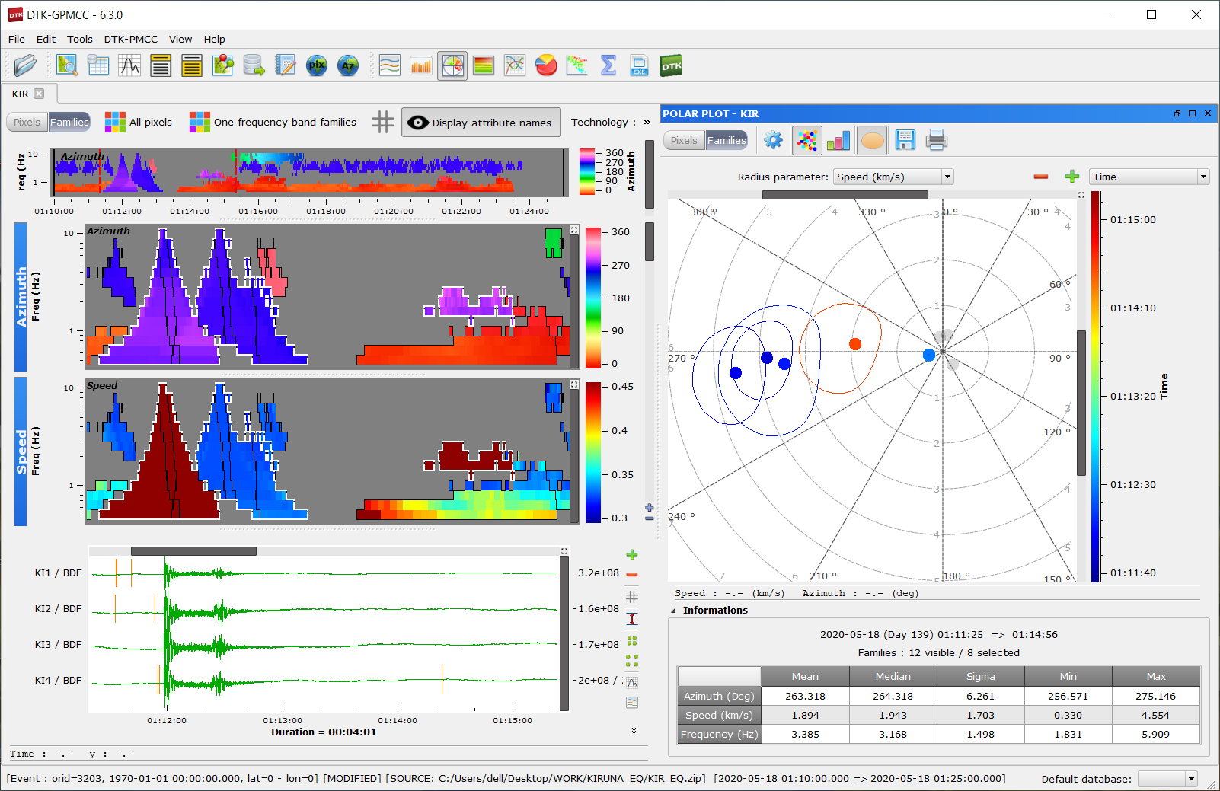
Seismo-acoustic analysis of Mw 4.2
mining induced earthquake nearby Kiruna, Sweden
Dr Antoine L. Turquet, Researcher, Norwegian Seismic Array (NORSAR), Kjeller, Norway
P2.3-149
Near-field
In near-field we were able to compare the seismic and infrasonic arrivals. PMCC results show that the azimuths are 4-5 degrees apart from each other.
Based on the celerity we can say the infrasound signal has a tropospheric arrival [310-341 m/s] (Le Pichon, 2010).
Mean frequency of both infrasound and seismic signals are very close to each other which indicates a good seismo-acoustic coupling and low high-frequency attenuation thanks to short distance.
RESULTS
Station KIR | Azimuth (deg) | Speed (km/s) | Mean Frq(Hz)
Infrasound | 258.3±1.4 | 0.330±0.001 | 3.59±1.47
Seismic | 266.0±1.9 | 3.961±0.445 | 3.59±1.51

Slide 10
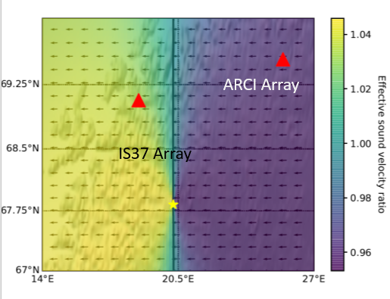
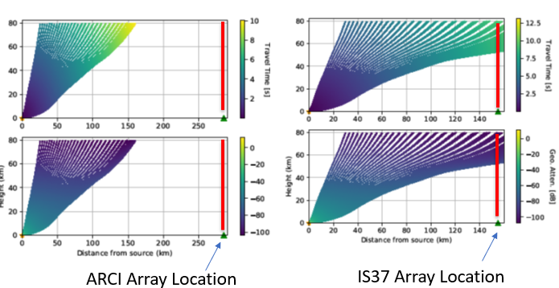
Seismo-acoustic analysis of Mw 4.2
mining induced earthquake nearby Kiruna, Sweden
Dr Antoine L. Turquet, Researcher, Norwegian Seismic Array (NORSAR), Kjeller, Norway
P2.3-149
Far-field: wind models – raypath analysis
An effective sound velocity map can be generated including the wind velocity calculated using ECMWF operational analysis/prediction model product.
Effective velocity map show the impact of wind and temperature on the wave.
Eff. Vel > 1 -> expected refraction to surface
RESULTS
Ray-tracing indicates that we do not observe any stratospheric arrival at the stations.
Atmospheric models are not sufficient to explain.
Wind perturbations due to gravity waves can enable refracting.

Slide 11
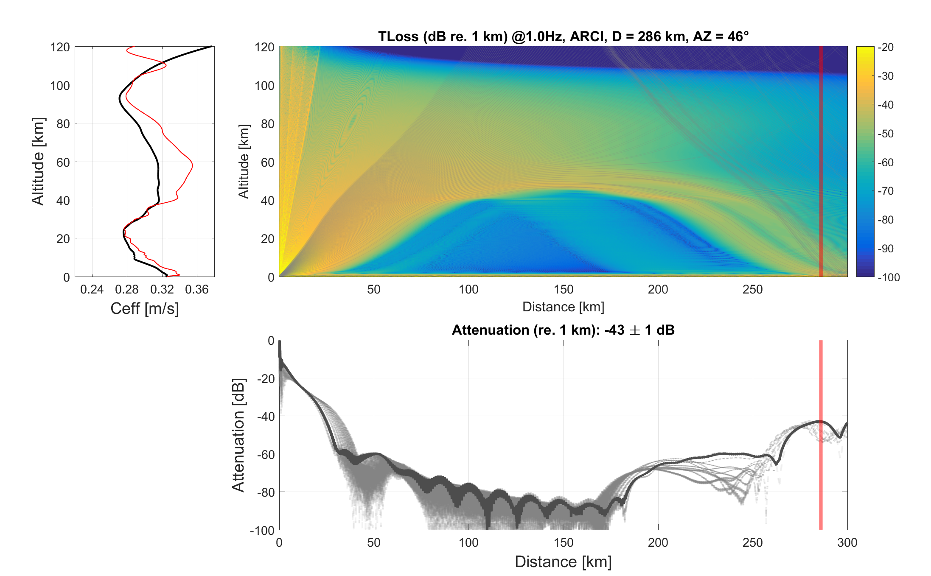
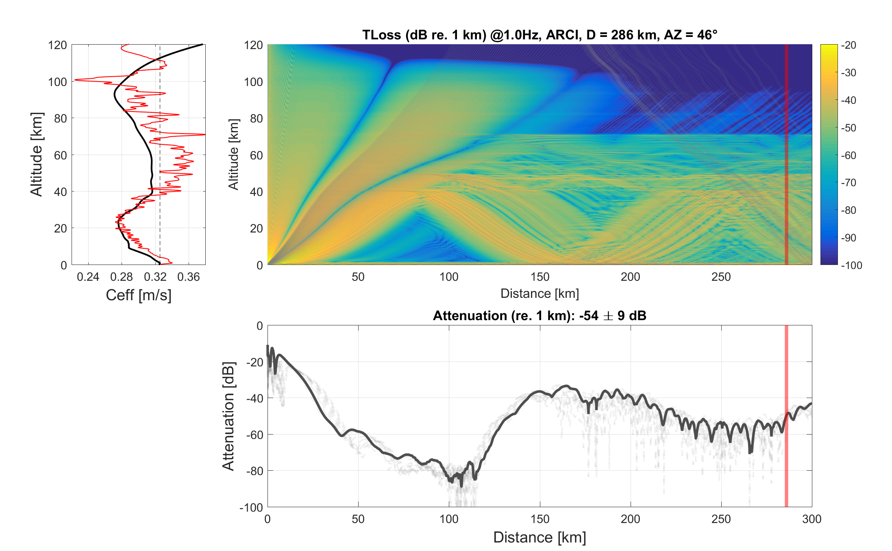
Seismo-acoustic analysis of Mw 4.2
mining induced earthquake nearby Kiruna, Sweden
Dr Antoine L. Turquet, Researcher, Norwegian Seismic Array (NORSAR), Kjeller, Norway
P2.3-149
Far-field: full-waveform simulations
ARCI Station full-waveform simulations with parabolic equation at 1Hz. Then, we include gravity wave perturbations as indicated in Gardner et al. 1993 to simulated waveform propagations.
Gravity wave perturbations helps waveforms refract earlier towards the ground thus explain better our recordings.
Without gravity wave perturbations
With gravity wave perturbations
Non-perturbed / Perturbed
velocity models
RESULTS
Red line: Location of the receiver
Gardner, C. S. et al. (1993).JGR: Atmos, 98(D1), 1035-1049.

Slide 12
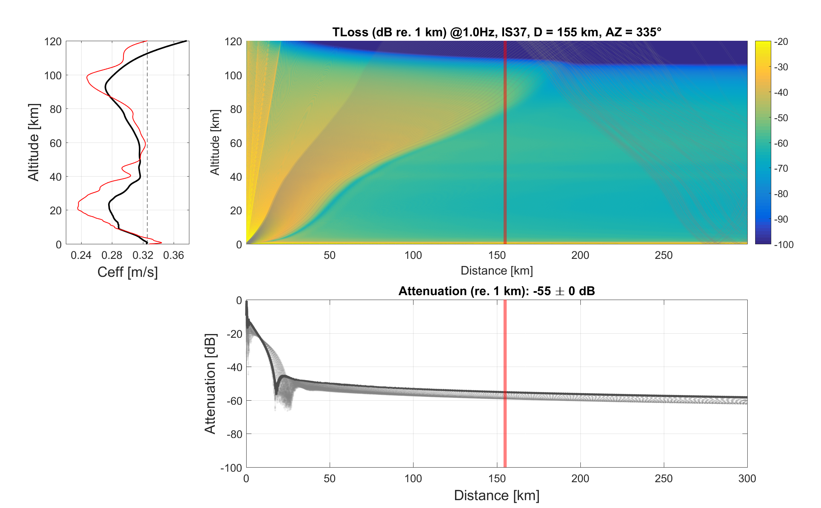
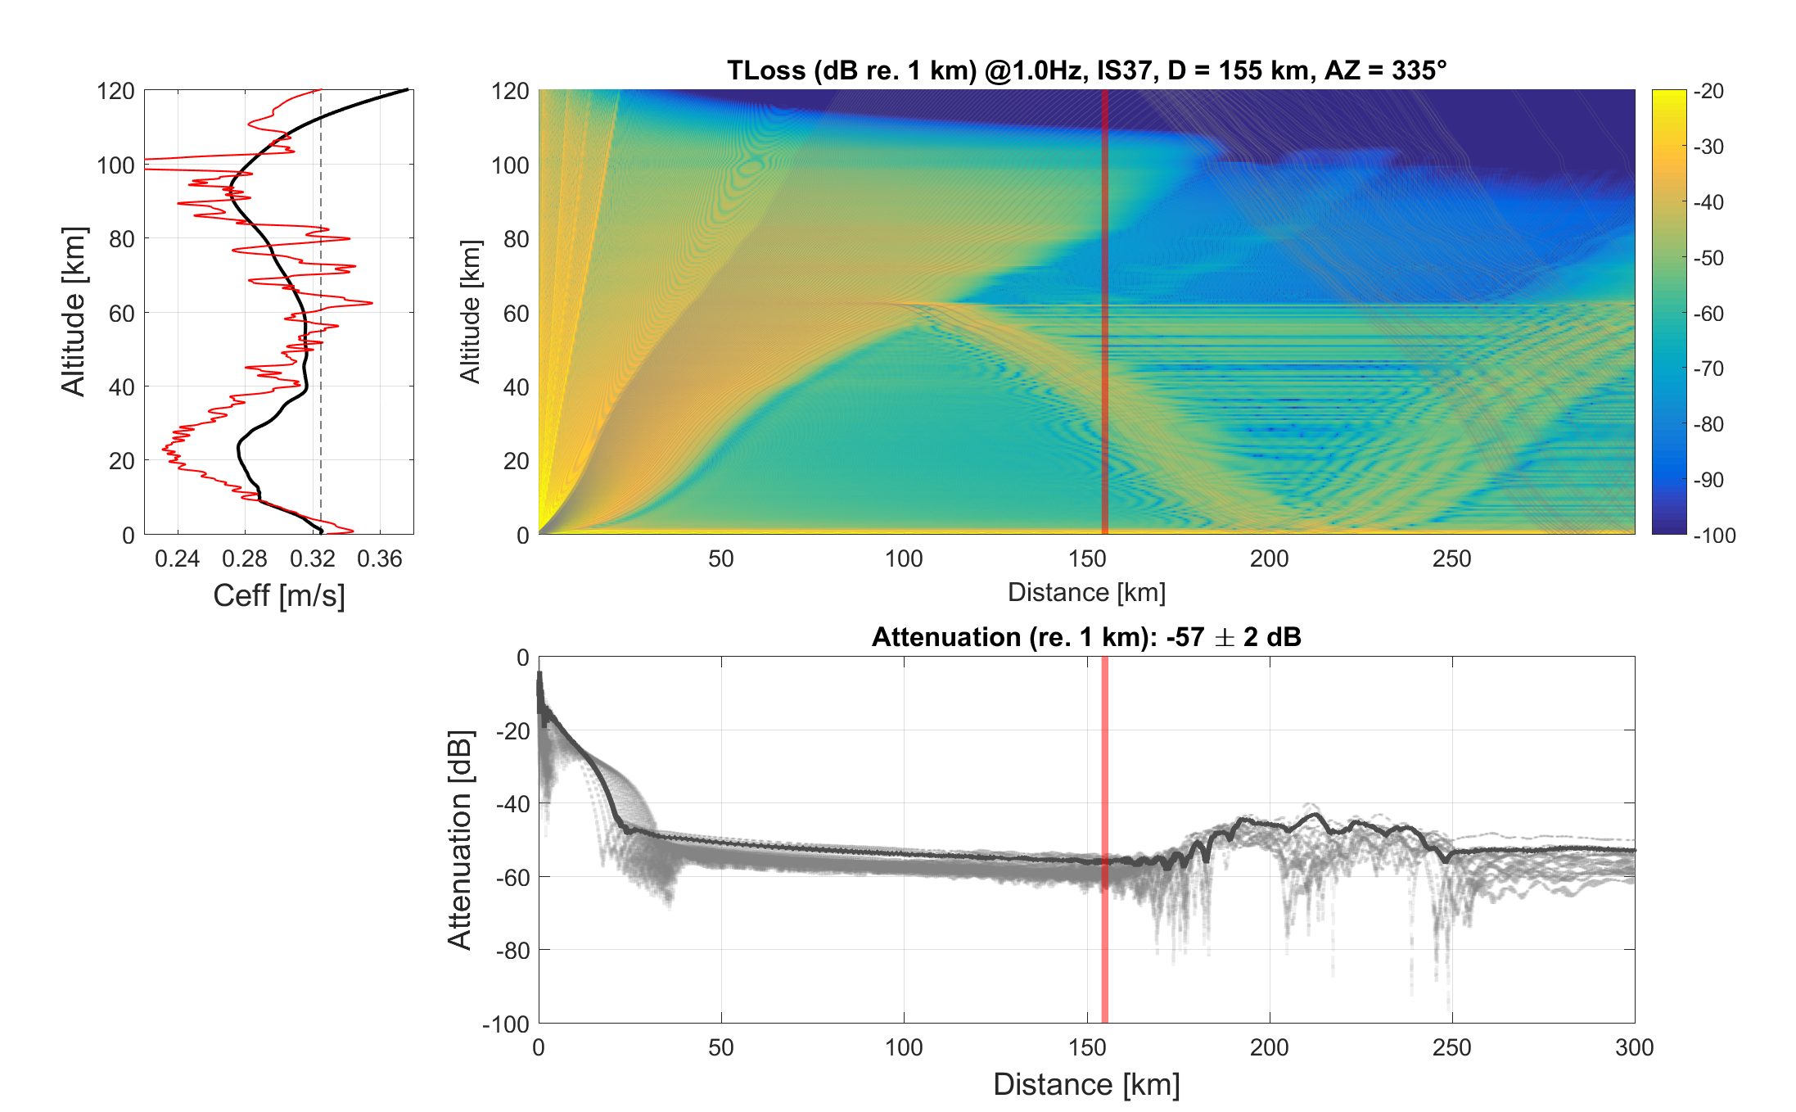
Seismo-acoustic analysis of Mw 4.2
mining induced earthquake nearby Kiruna, Sweden
Dr Antoine L. Turquet, Researcher, Norwegian Seismic Array (NORSAR), Kjeller, Norway
P2.3-149
Far-field: full-waveform simulations
IS37 Station full-waveform simulations with parabolic equation at 1Hz. Heavily perturbed signals explain better the infrasound arrival to IS37 however this is still not perfect.
-> Atmospheric models need to be improved to explain those arrivals
Without gravity wave perturbations
With gravity wave perturbations
Non-perturbed / Perturbed
velocity models
RESULTS
Red line: Location of the receiver

Slide 13
Seismo-acoustic analysis of Mw 4.2
mining induced earthquake nearby Kiruna, Sweden
Dr Antoine L. Turquet, Researcher, Norwegian Seismic Array (NORSAR), Kjeller, Norway
P2.3-149
Kiruna minequake was strong enough to couple to the atmosphere and propagate to large distances.
Moment tensor studies show that the source mecanism is more complex than ordinary mine collapse.
Having a coupled study with seismic recordings we can obtain information about the cross-wind velocity, atmospheric conditions.
Backpropagation of near-field infrasound data provided a map of seismo-acoustic coupling over the mine.
More study about the aftershock and source mechanisms will follow. Stay tuned!
CONCLUSIONS

